Slide 1

ST.ANN’S COLLEGE OF ENGINEERING AND TECHNOLOGY DEPARTMENT OF ELECTRCAL AND ELECTRONICS ENGINEERING MAT LAB SIMULATION OF GRID CONNECTED PV SYSTEM USING HYSTERESIS CURRENT CONTROL INVERTER
BATCH-5
PROJECT ASSOCIATES
N.LAKSHMI TIRUPATHAMMA (10F01A0285)
M.RAJESH (10F01A0278)
K.NAGA VAMSI (11F05A0212)
R.LOHITHA (10F01A0297)
UNDER THE GUIDENCE OF
Mr. P.SRAVAN KUMAR M.Tech

Slide 2
Contents
Abstract
Introduction
Modeling of solar PV system
Modeling of DC-DC boost converter
Modeling of DC-AC Grid Connected Inverter
Conclusion
References

Slide 3
Abstract
The solar photovoltaic (PV) system uses solar energy to produce electricity and is one of the major renewable energy sources. In this project we are using MATLAB/simulink and SIM power system tool. This project aims to grid-connected solar PV system at steady state and also to study their transient responses to changing inputs.
In the solar PV modeling a circuit-based simulation model for a PV cell in order to allow estimate the electrical behavior of the cell with respect to changes on environmental parameter of temperature and irradiance. The power conditioning unit consists of a DC-DC Boost Converter and a full-bridge inverter. Currently models of a Solar Photo voltaic module and Power conditioning unit have been developed.

Slide 4
Introduction
Renewable energy sources are ones which don't run out - which can be renewed. We can keep using them and using them, and we'll never run out. Examples of renewable sources include wind, water power (hydroelectric), and solar power (light from the sun).
Non-renewable energy sources are ones which do run out. As we use them to generate energy, they get used up, and can't be used a second time. There are three main non-renewable energy sources, which are fast running out: coal, oil and natural gas.

Slide 5
Examples of Renewable Energy Sources
Solar Energy
Wind Energy
Bio Energy
Geothermal Energy
Ocean Energy
Small Hydro etc..

Slide 6
Physics of Photovoltaic Generation
n-type semiconductor
+ + + + + + + + + + + + + + +
Depletion Zone
- - - - - - - - - - - - - - - - - -
p-type semiconductor

Slide 7
PV technology classification
Silicon Crystalline Technology Thin Film Technology
Mono Crystalline PV Cells Amorphous Silicon PV Cells
Multi Crystalline PV Cells Poly Crystalline PV Cells
( Non-Silicon based)

Slide 8
Advantages
Direct conversion of light to electricity through a simple solid state device
Absence of moving parts
Maintenance cost is low
Easy to operate
They do not create pollution
They have long effective life
High reliable
High power to weight ratio so it is applicable in space application and roof loading

Slide 9
Limitations
High capital cost
Storage battery is required at night when sun radiation is not available.
Power output is less.
Solutions
These limitations can be overcome by improving the technology of manufacturing of solar cell and storage system
Mass production can reduce the cost.
Power output can be increased by using MPPT

Slide 10
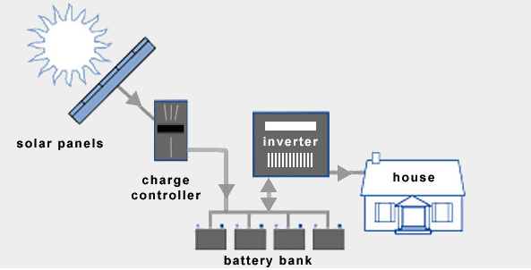
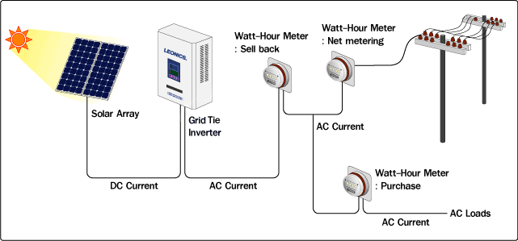
continue…
Types of PV System
Stand alone system
Grid connected system

Slide 11
Modeling of solar PV system
Figure: Circuit diagram of solar PV module

Slide 12
Mathematical Modeling of PV cell
I = I_{L} - I₀(e^{q(V +IRS)/nkT} - 1) (1)
I_{L} = I_{L}(T₁)(1 + K₀(T-T₁)) (2)
I_{L}(T₁) = G * I_{SC}(T₁,nom)√G(nom) (3)
K₀ = (I_{SC}(T₂) - I_{SC}(T₁))/(T₂ - T₁) (4)
I₀ = I₀(T₁) * (T/T₁)^{3/n}*e^{-qVq/nk*(1/T-1/T1)} (5)
I₀(T₁) = I_{SC}(T₁)/(e^{qVOC(T1)/ nkT1} - 1) (6)
R_{S} = -dV/dIV_{OC} - 1/X_{V} (7)
X_{V} = I₀(T₁) * q/nkT₁ * e^{qVOC(T1)/nkT1} (8)

Slide 14

Efficiency
Fill factor

Slide 15
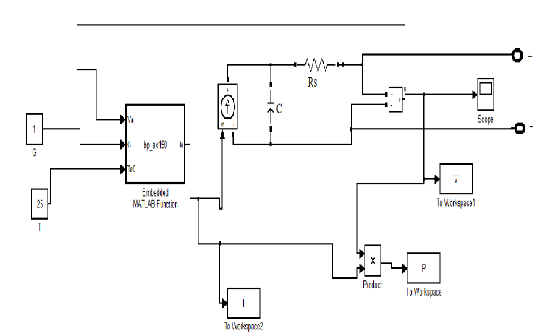
Simulink model of solar PV

Slide 16
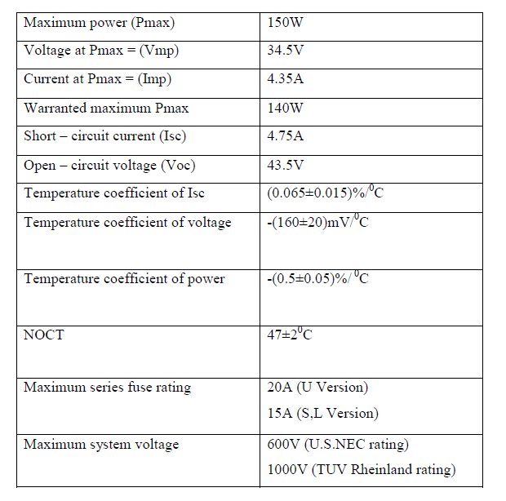
Electrical characteristics of BPSX 150 solar cell at 25⁰C, 1000w/m²

Slide 17
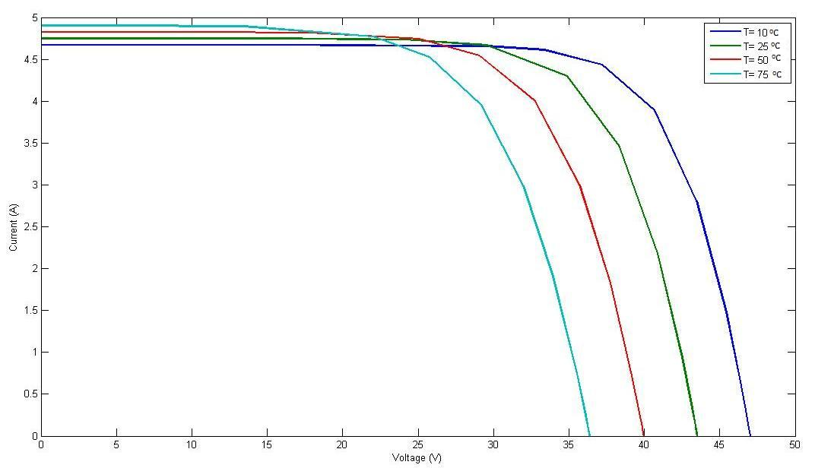
I-V characteristic for a PV cell at constant G= 1000W/m2

Slide 18
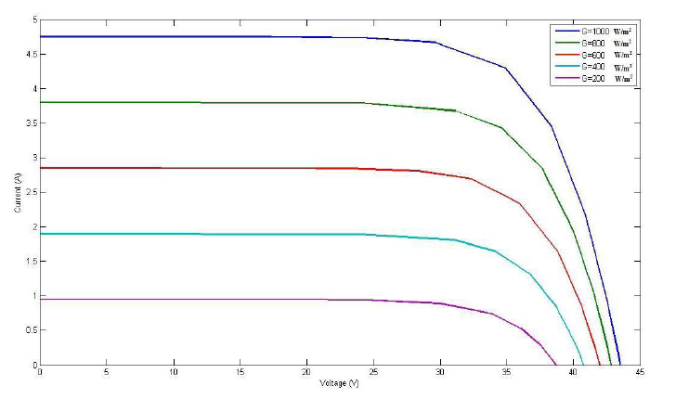
I-V characteristic for a PV cell at a constant temperature of 25⁰C

Slide 19
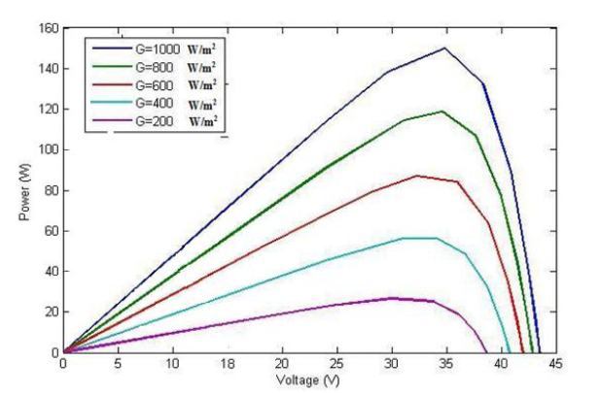
P-V characteristic for a PV cell at a constant temperature of 25⁰C

Slide 20
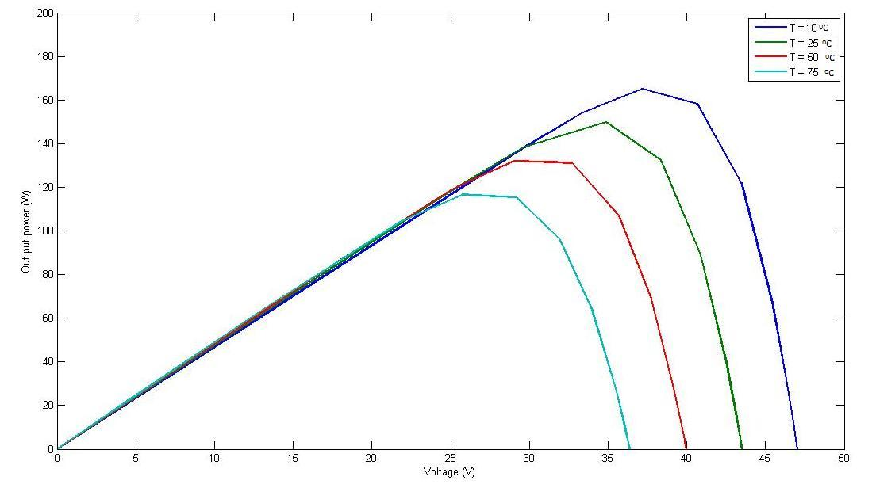
P-V characteristic for a PV cell at constant G= 1000W/m²

Slide 21
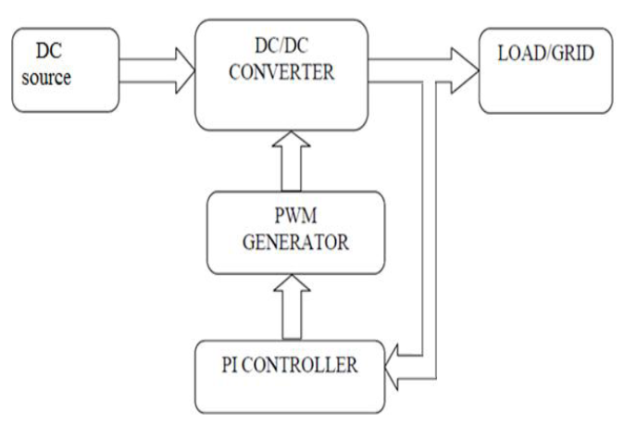
Modeling of DC-DC boost converter

Slide 22
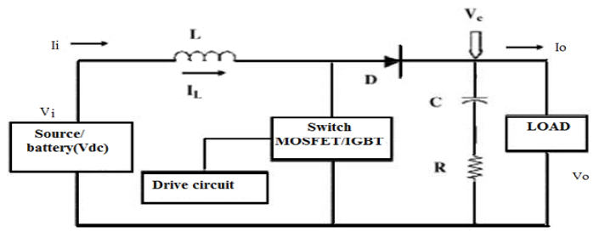
Modeling of DC-DC converter
P_{in}= V_{i} * I_{i}
I_{i} = I_{L}
D =1-(V_{i}/V₀)
For continuous conduction the designed values of L, C, R is
L = (D (1-D)*R) / (2*f)
C = (D/2*f*R)
Where
“D‟ is the Duty Ratio
“R‟ is the load resistance
“f‟ is the switching frequency

Slide 23
PI Controller for DC-DC Boost Converter Output Voltage
Open Loop, DC-DC Converter Process
Hold to V_{set}
error
V
pwm
PI
PWM mod.
DC
-
DC
V
set
controller
and MOSFET
conv.
V
out
+
driver
–
DC-DC Converter Process with Closed-Loop PI Controller

Slide 24
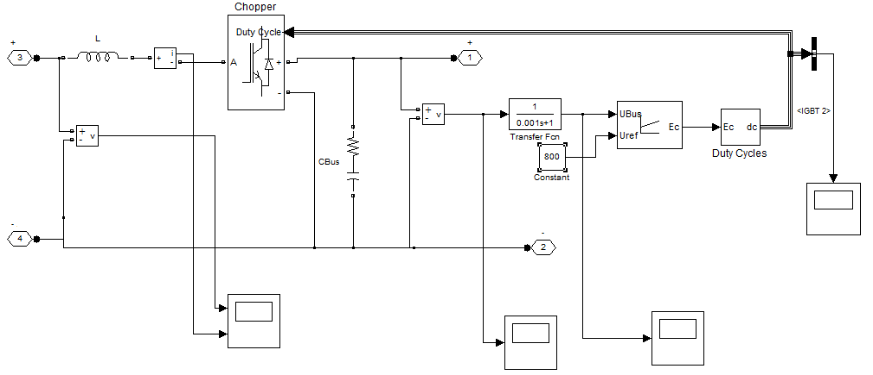
Simulink Model of DC/DC Converter

Slide 25
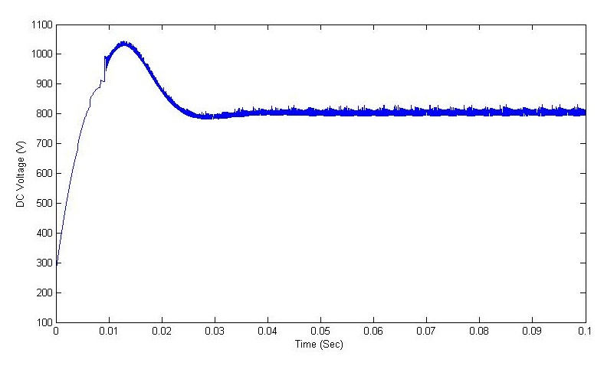
Output Voltage Waveform Of DC/DC Converter

Slide 26
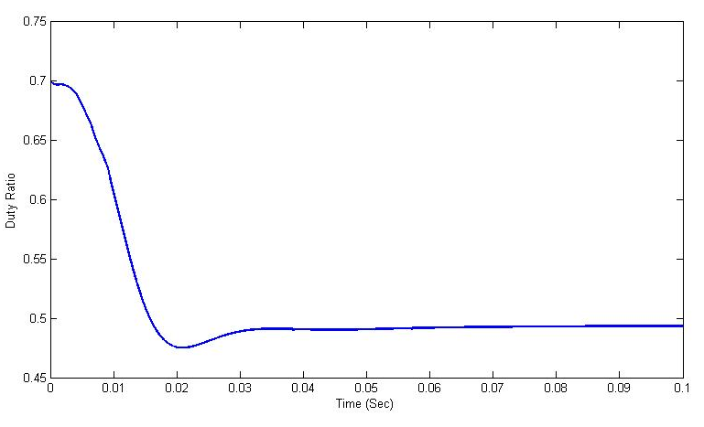
Duty ratio of DC/DC Converter

Slide 27
Modeling of DC-AC Grid Connected Inverter

Slide 28
Control Block
CURRENT CONTROL
Among multiple functions of grid connected systems, the current control plays one of the most important roles. The performance of the complete system largely depends on the quality of the applied current control strategy. It has to full fill basic requirements, such as low harmonic distortion of the output current, high dynamic response, regulation of the dc-link voltage and, in a number of cases, provide bi-directional power flow.

Slide 29
HYSTRESIS CONTROL
The basic concept of the hysteresis current control is to switch the output voltage level (+V_{dc} to −V_{dc} for a two-level system) appropriately whenever the measured current goes above or below a given tolerance boundary. The current errors resulting from the comparison between measured currents and respective phase current references are controlled using three independent hysteresis comparators
Figure : Hysteresis Current Control

Slide 30
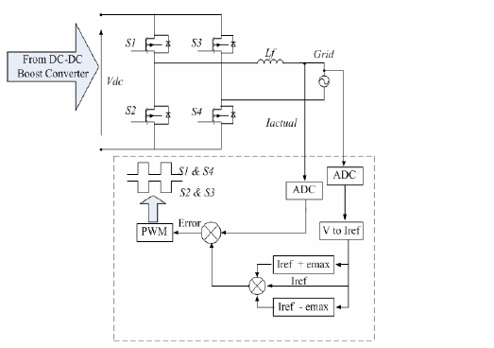
Figure: DC/AC converter control loop

Slide 31
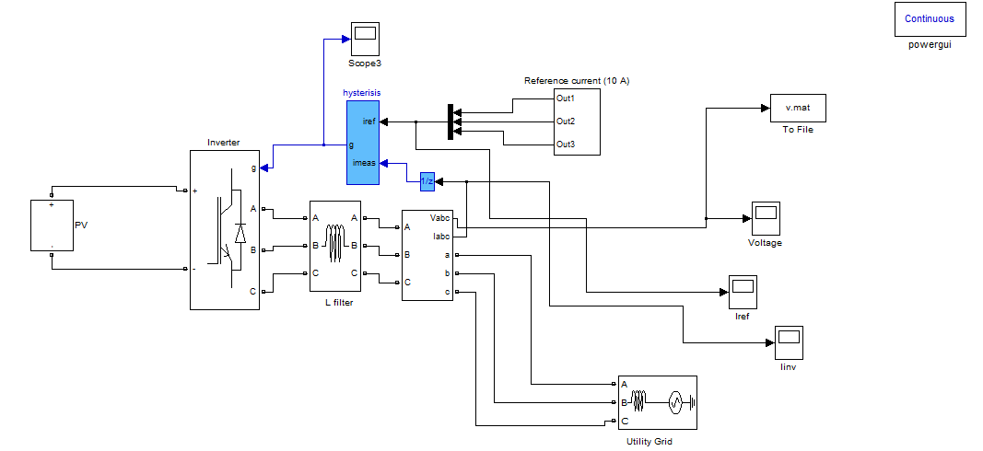
Simulink model of Grid Connected inverter

Slide 32
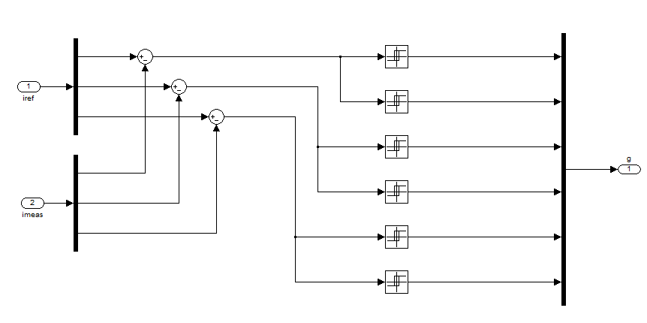
Simulink model of Hysteresis 6 pulse generator

Slide 33
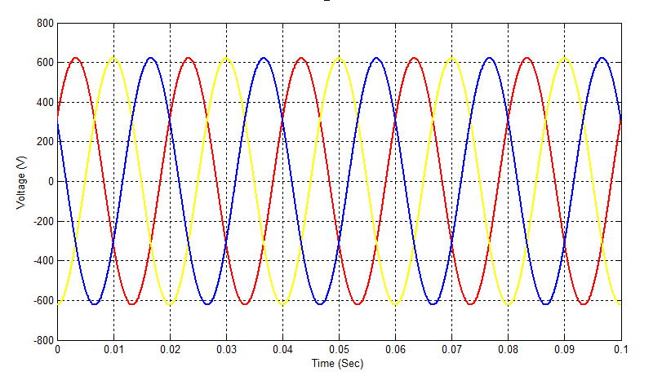
Output Voltage of Grid-Connected Inverter

Slide 34
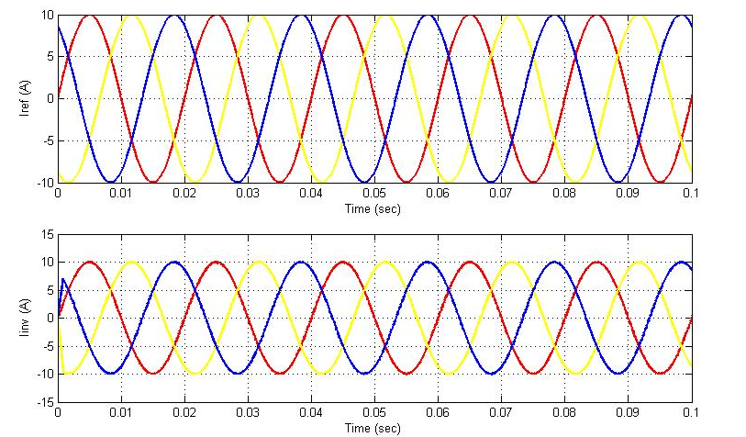
Current Response of Grid-Connected Inverter

Slide 35
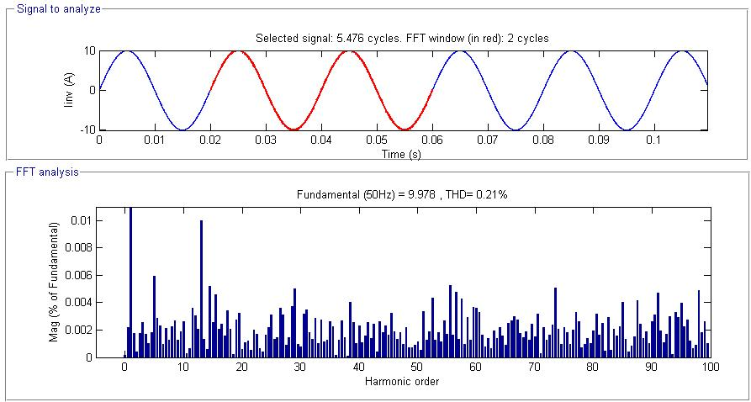
% of Total Harmonic Distortion (THD)

Slide 36
conclusion
This project presents the characteristics of Solar PV cell for BPSX150 model and the modeling of DC-DC boost converter and Hysteresis Current Control Grid Connected Solar PV system behavior have been developed. The results of the solar PV system provide the current and the inverter tracks the reference current from the solar PV and supplies to the utility grid.

Slide 37
References
T.E Hoff, H.J Wenger, and B.K. Farmer. Distributed generation: An alternative to electric utility investments in system capacity. Energy Policy, 24(2):137 – 147, 1996.
S. Blazwicz and D. Kleinschmidt. Distributed generation: System interface. [Online]., May 1999.
T. Ackermann and V. Knyazkin. Interaction between distributed generation and the distribution network: operation aspects. In Transmission and Distribution Conference and Exhibition 002: Asia Pacific. IEEE/PES, volume 2, pages 1357–1362, Oct 2002.
B. Lindgren. A Power Converter for Photovoltaic Applications. PhD thesis, Department of Electric Power Engineering, Chalmers University of Technology, Göteborg, Sweden, 2000.
G. Walker, "," Journal of Electrical & Electronics Engineering, Australia, IEAust, vol.21, No. 1, 2001, pp.49-56.

Slide 38
Thank you

